Slide 1

Cloud security

Slide 2
Presented by
Omkar Zaware -3092
Rajat Davale -3058
Adesh

Slide 3
What is cloud security?
Cloud security, also known as cloud computing security, is a collection of security measures designed to protect cloud-based infrastructure, applications, and data. These measures ensure user and device authentication, data and resource access control, and data privacy protection.

Slide 4
What are the 5 Key Areas of Cloud Security ?
Identity and access management.
Securing data in the cloud.
Securing the operating system.
Protecting the network layer.
Managing security monitoring, alerting, audit trail, and incident response.

Slide 5
How does security cloud work?
With cloud web security; traffic gets to the cloud instead of being routed to the servers directly. The cloud analyses the traffic and only allows legitimate users to gain access. Any traffic that the cloud does not approve, it blocks it from getting to the server.

Slide 6
Why is cloud security important?
Improve disaster recovery: through a secure cloud, you can easily back up important data and recover it in the event of a disaster at your office locations. Remote workers can also do the same, as there's no need to physically connect to a network.

Slide 7
What are the three main goals of security?
Integrity: Making sure people cannot change information they should not (protecting data)
Availability: Making sure people cannot stop the computer from doing its job.
Confidentiality: Making sure people cannot acquire information they should not (keeping secrets)

Slide 8
What is purpose of security?
Security purpose means the purpose of preventing shoplifting, fraud, or any other misappropriation or theft of a thing of value, including tangible and intangible goods, services, and other purposes in furtherance of protecting the security or integrity of software, accounts, applications, online services, or any ...

Slide 9
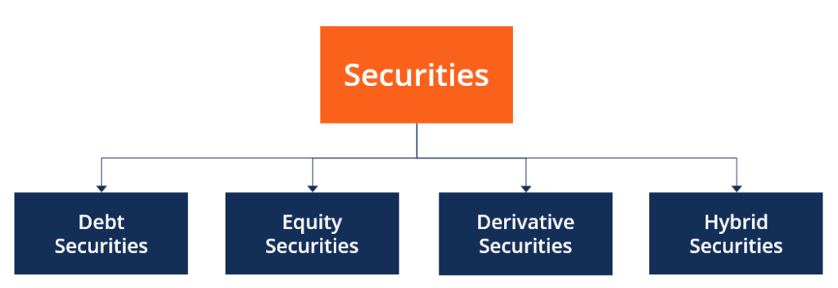
What are types of security?

Slide 10
Debt Securities
Debt securities, such as bonds and certificates of deposit, as a rule, require the holder to make the regular interest payments, as well as repayment of the principal amount alongside any other stipulated contractual rights. Such securities are usually issued for a fixed term, and, in the end, the issuer redeems them.
Equity Securities
Equity securities represent ownership interest held by shareholders in a company. In other words, it is an investment in an organization’s equity stock to become a shareholder of the organization.

Slide 11
Derivative Securities
Derivative securities are financial instruments whose value depends on basic variables. The variables can be assets, such as stocks, bonds, currencies, interest rates, market indices, and goods. The main purpose of using derivatives is to consider and minimize risk.
Hybrid Securities
Hybrid security, as the name suggests, is a type of security that combines characteristics of both debt and equity securities. Many banks and organizations turn to hybrid securities to borrow money from investors.

Slide 12
Thank YOU!!

